Slide 1
Lending Club Case Study SUBMISSION
Group members:
Siddakka Saptasagare
Kumaraguru Muthuraj

Slide 2
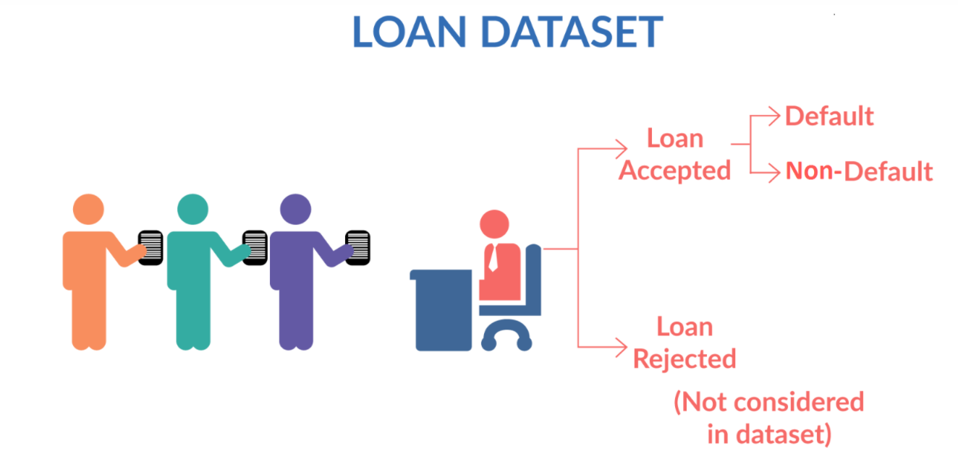
Objective of the case Study
When applicants apply for the loan there will be 2 possible cases:
Loan Accepted
Loan Rejected
When Loan is accepted it has 3 possible results as below:
Fully Paid: applicant pays the full loan amount
Current: applicant is still paying the EMI
Charged off : applicant has not paid the loan for some period of time. He/She may become defaulter
When the loan defaults, it will cause great loss to the lending company.
Identifying the risky loan applicants and the driving factors for the loan default will benefit the company.

Slide 3
Analysis and Problem Solving process
Understanding the Business Objective
Loading the input data set
Cleaning and standardizing the data
Exploratory data analysis
- Load the data file
- Extract and read the csv
- Drop unused columns
- Convert data type to correct format
- Perform univariant analysis
- Check the distribution and frequency of data
- Create derived columns to ease the analysis process
- Perform bivariant analysis
- Check the impact of variable on loan status
- Check the correlation b/w numeric variables
- Filter the data as per highest significant factor
- Perform multivariant analysis
- Plot different graphs to visualize the results
- Summarize the result
- Conclusion about the loan risk factor

Slide 4
Risk factors identified by analyzing 2011 data, which we
felt is representative of the entire population
Risk 1 - Loan grades E, F and G are higher risk loans. Looks like LC is already charging higher interest rate to recover faster. When LC issues a high loan amount they have to look at other risk factors listed further.
Risk 2 - Most of the loans above interest rate 15% are at the risk of being charged-off. Higher the interest rate they might be charged-off.
Risk 3 - Looks like charged-off loans are from a slightly higher loan amount in the order of 12K and higher. Higher the loan amount its more risky.
Risk 4 - Debt consolidation, credit card, small business, other and home improvement reasons have highest charged off debts.
Risk 5 - Rental and Mortage home dwellers have higher charged-off status than owners. A customer from rental home is risky, followed by mortgagers.
Risk 6 - The ratio of bankruptcy counts to none is higher for charged-off customers. If a customer declared bankruptcy before, he is more likely to default.
Risk 7 - States grouped based on geography, indicate West region has taken more loans. A loan request from western states is risky, especially California.

Slide 5
Risk factors identified by analyzing charged-off
loans by top4 states, top4 issued months and top4 purposes
Risk 8 - For either terms, if the interest rate is reduced, defaulting behavior can be reduced.
Risk 9 - Its risky to give loans to customers with credit history between 5 to 15 years. For both terms with credit_history, note that the defaulters drastically reduce for both terms 36 and 60 as the credit_history (age of the person) increases.
Risk 10 - Issuing loans in Sep-Dec (specifically Nov and Dec), for the 4 states with debt consolidation as purpose is risky. Customers ask for loan with debt consolidation as a reason in the 4 (especially California) states and default maximum. Towards the end of the year, as celebration begins, customers prepare to take the loan and spend-off and default.
Risk 11 - Giving loan to a customer with credit history between 5 - 15 years in the top 4 states, for the last quarter of the year, for top 4 purposes is risky.
Risk 12 - Lending money to customers fitting top 4 criteria with employment length less than 2 years is risky.
Risk 13 - If a customer fitting top 4 criteria in rental home, applies for loan with purpose debt consolidation in the last 4 months, its risky.
Risk 14 - For rental customers, revolving utilization is highest, and specifically, it reduces as they spend more number of years with the same employer. So many reasons for calling rental clients risky.
Risk 15 - When loans are issued without source verification, they are very risky.
Risk 16 - Rental home defaulters, default within the first 6, 12 and 18 months, if they are employed for a shorter time in their current job.
Risk 17 - Its risky to give loan to rental customers, because its risky to recover the amount incase of default.
Risk 18 - Risky to give loans to rental customers with higher DTI.

Slide 6
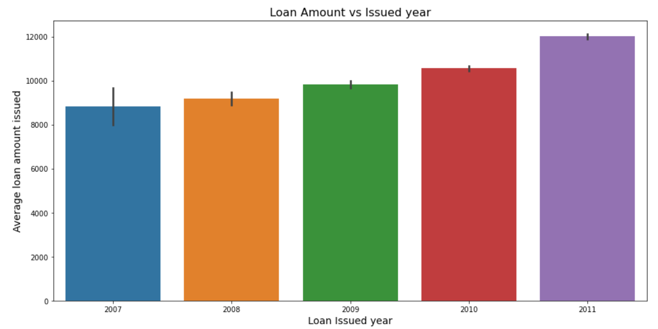
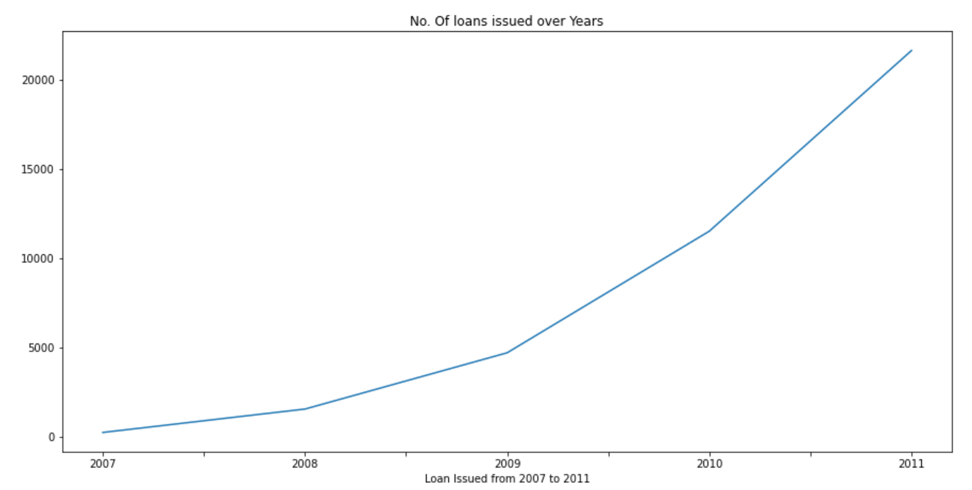
Analysis of Loan amount issued
As shown in the below graphs the loan amount issued varies from 5000 to 20000
Amount of loan issued and no. of loans are increasing over the years from 2007-2011

Slide 7
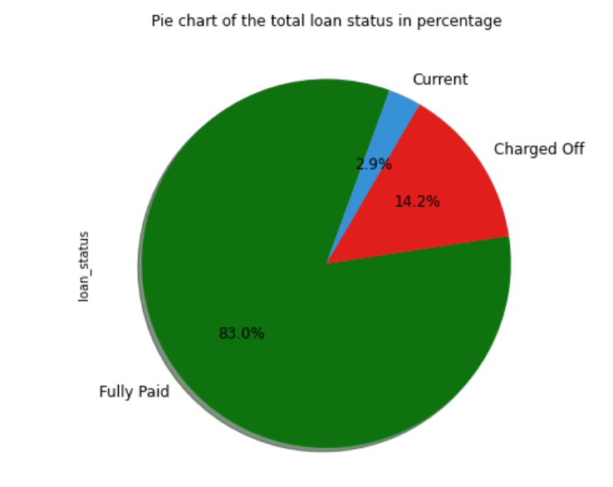
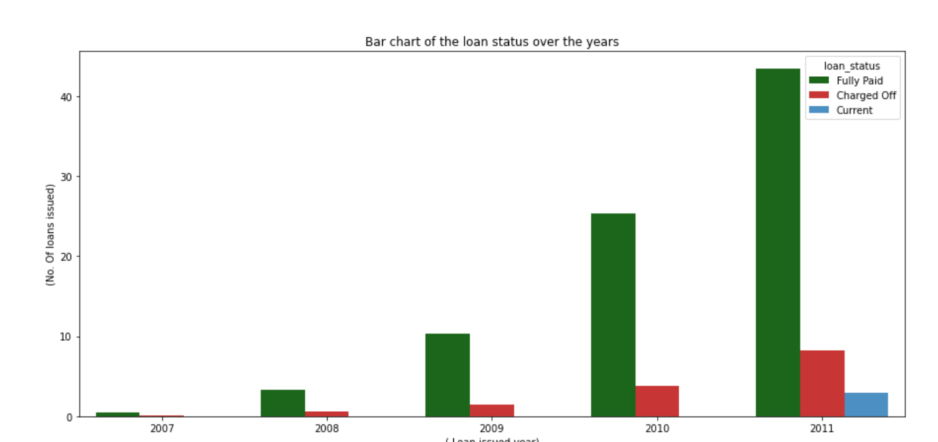
Analysis of loan status of total loans issued across years
As shown in the below graphs the total 14.2% loans are charged off
No. of charged off loans are increasing over the years

Slide 8
Identification of different factors of default loans
Analysis done by filtering data of year 2011
Loan status vs Grade analysis
Loan status vs Loan amount and interest rate analysis
Loan status vs income, loan to income ratio
Loan status vs Purpose of the loan
Loan status vs different regions
Loan status vs DTI, public bankruptcies and some credit history records
Analysis done by filtering the data of only charged off loan status
Loan status vs employment length
Loan status vs EMI term
Loan status vs Purpose of the loan
Loan status vs different regions and states

Slide 9
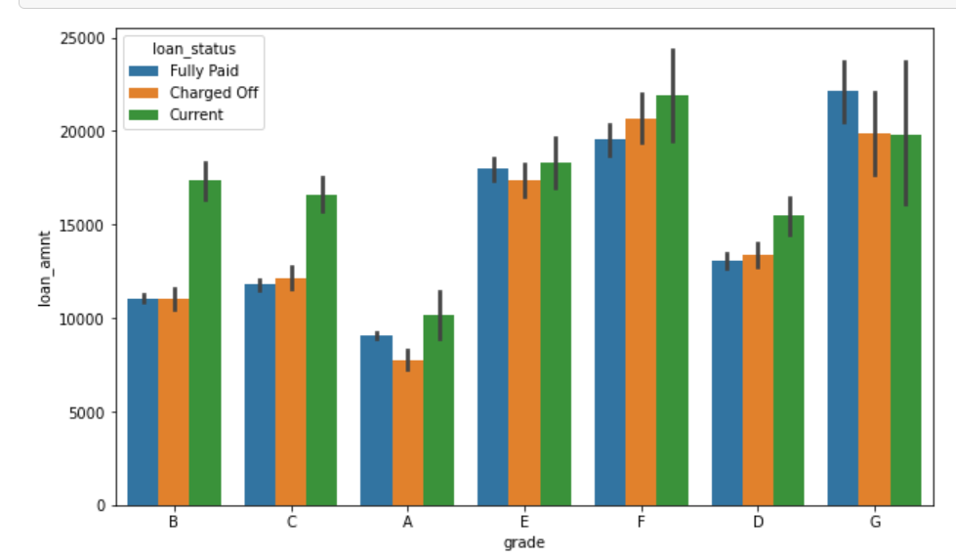
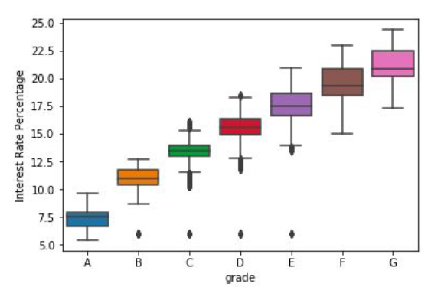
Loan status vs grade analysis
As shown in the below diagram maximum loans issued for grade E, F and G with loan amount > 15000 are charged off, and they have risk of becoming default loans
After checking grade vs loan interest we can see that E, F and G have received loan with >15 % interest

Slide 10
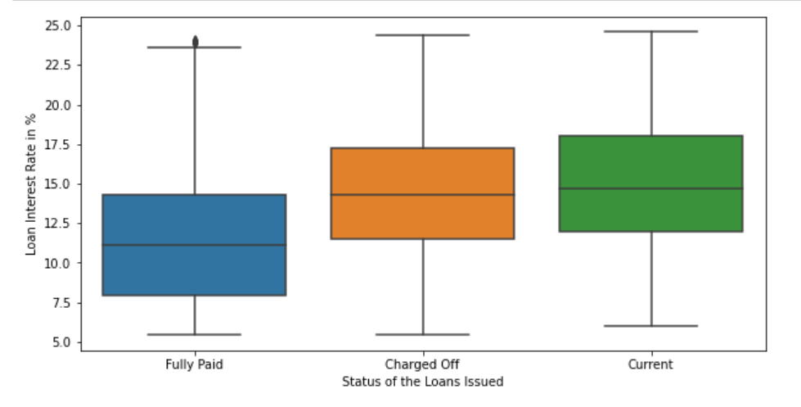
Loan status vs Interest rate analysis
As shown in the below plot, fully paid loans have interest rate <12.5% and are good loans
Loans having interest rate >12.5% are charged off and have the risk of becoming bad loans
We must accept the loans with interest rate <12.5%, to avoid the risk and loss

Slide 11
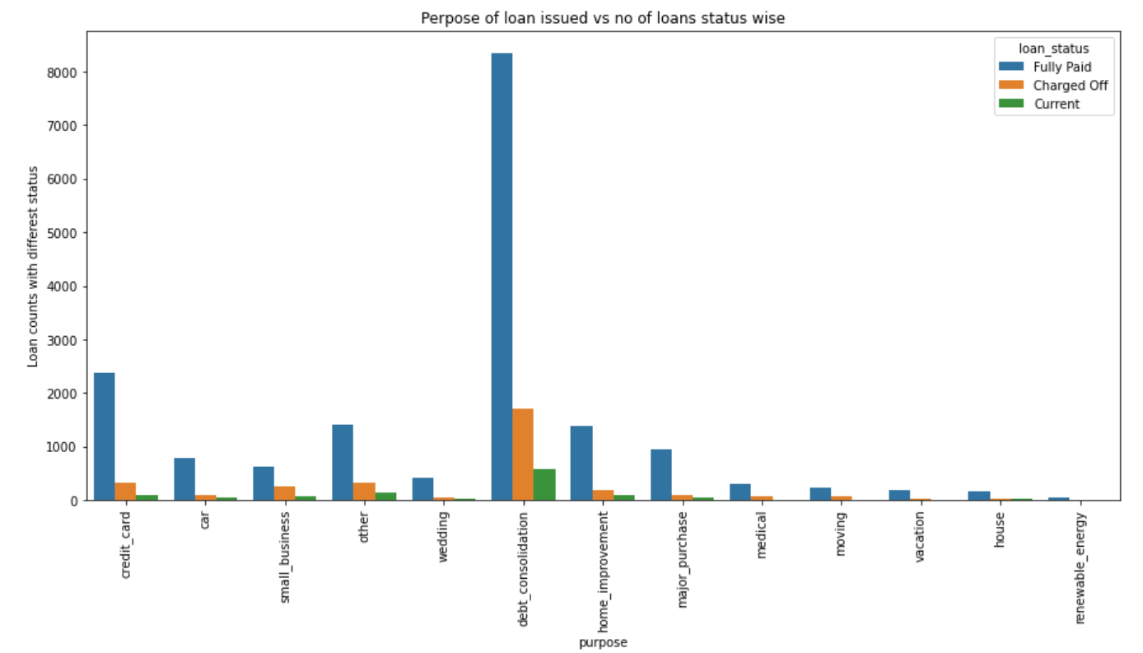
Loan status vs Loan purpose analysis
Top 5 purposes of borrowing the loans are Debt_consolidation, Credit_card, small business, other and Home_improvement
Maximum Loan issued for Top 5 purpose are being charged off

Slide 12
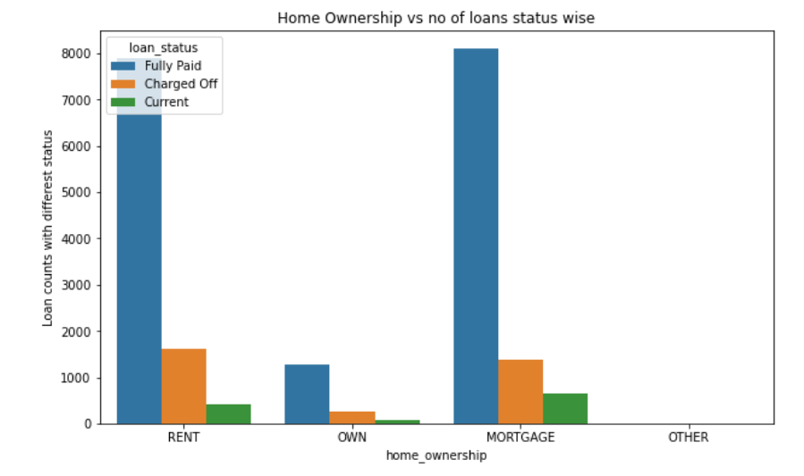
Loan status vs Home Ownership Analysis
Maximum loans are issued for customers having ownership as Rent and Mortgage
More applicants of Rent and mortgage home-ownership are charged off

Slide 13
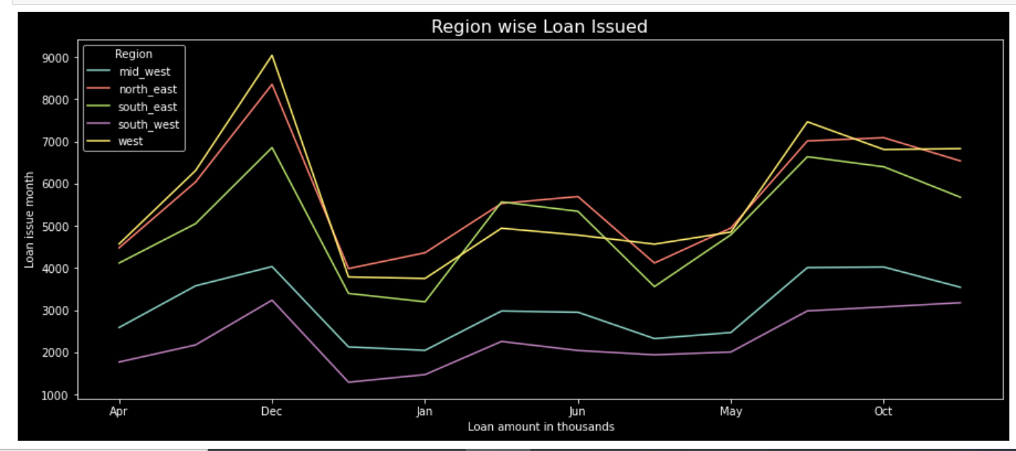
Loan status vs region analysis
Below graph shows that SouthEast , West and NorthEast regions had the highest amount of loans issued.

Slide 14
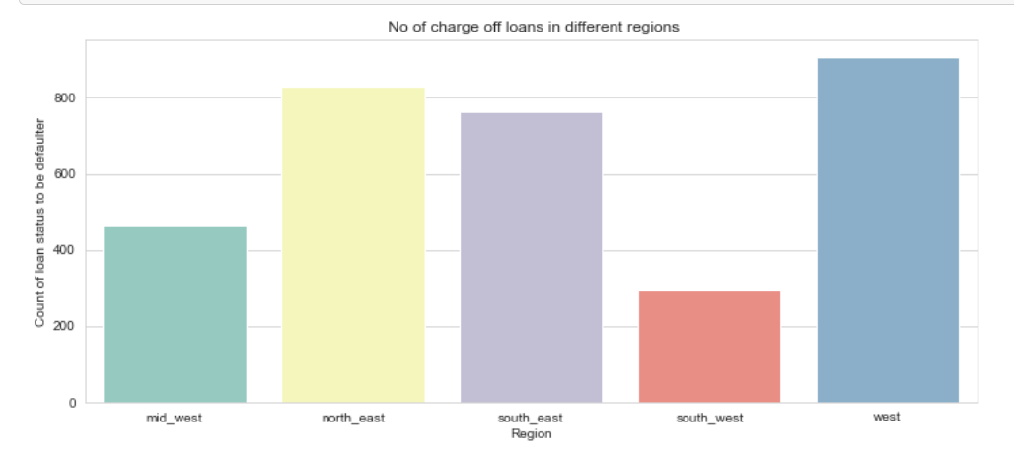
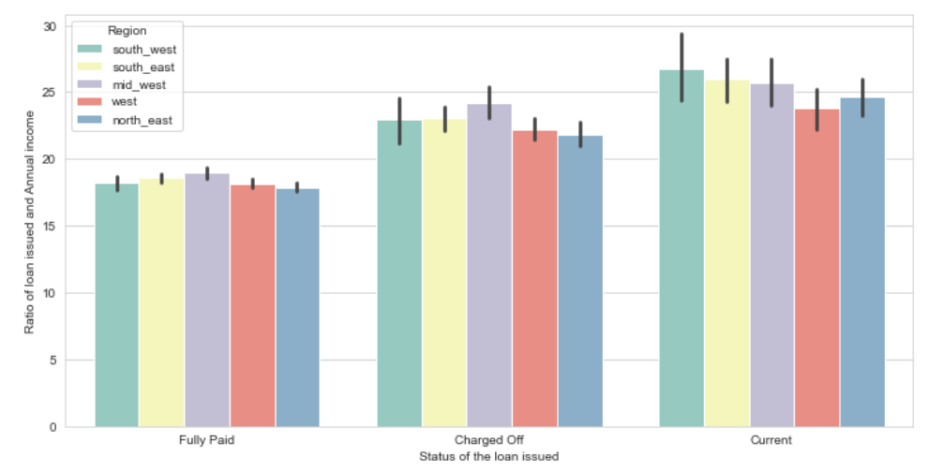
Continued…
Maximum Loans issued in the region of west are being charged off
West has the lowest loan to income ratio

Slide 15
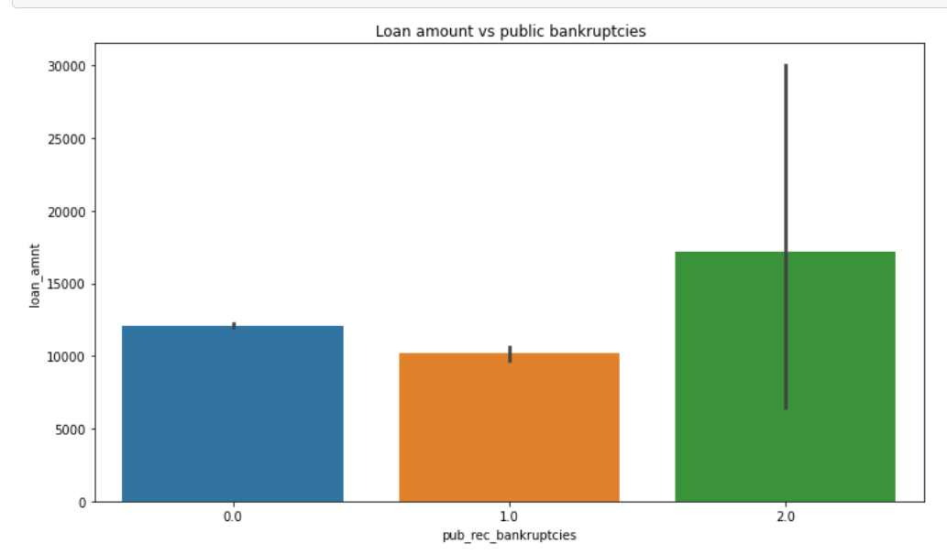
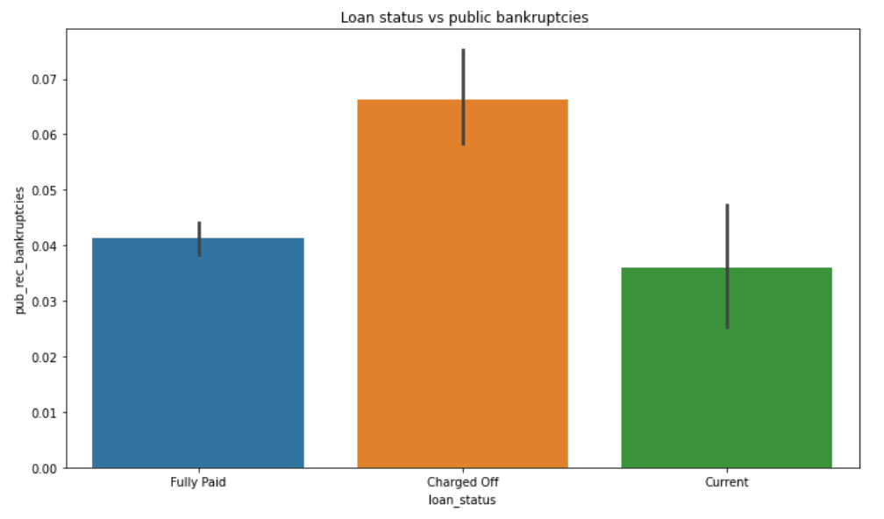
Loan status vs public bankruptcies
As the loan amount increases no. of bankruptcies declared also increases
Loan borrowers who have declared bankruptcies 1-2 times are more prone to becoming defaulters

Slide 16
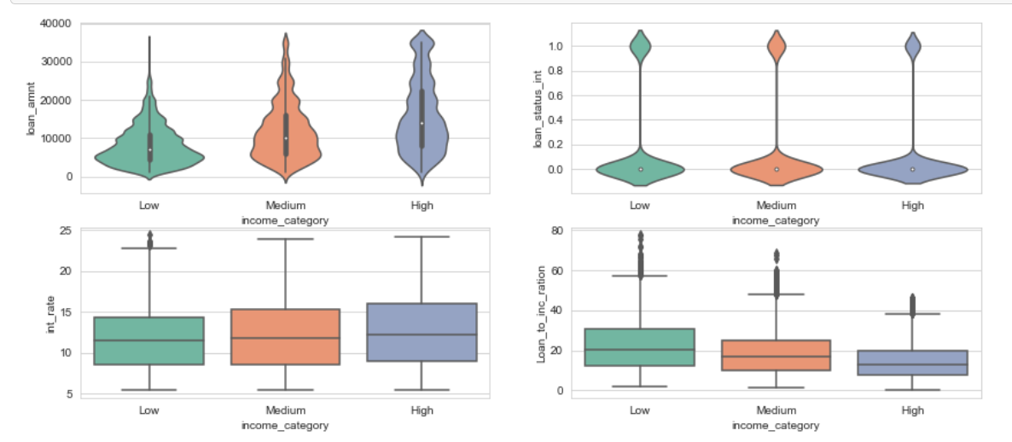
Loan status vs public bankruptcies
Loans of the high income category took higher loan amounts than people from low and medium income categories
Loans of the Low income category had a slightly higher chances of becoming a bad loan.
Loans of high income had on average higher interest rates
Loan of low income had average higher loan to income ratio

Slide 17
Plots and risk insights after this are obtained from the charged-off loans from top 4 states, top 4 purposes and top4 months when loans were issued

Slide 18
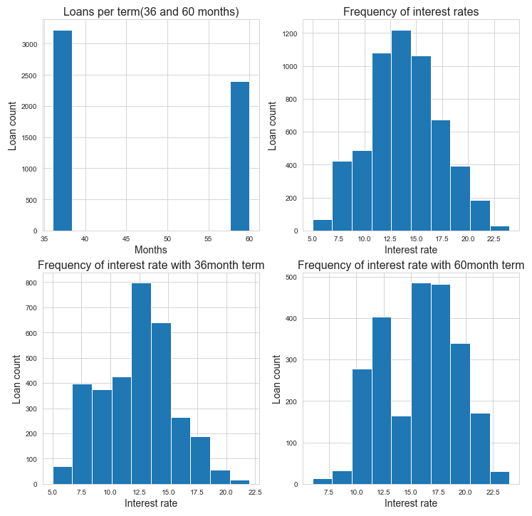
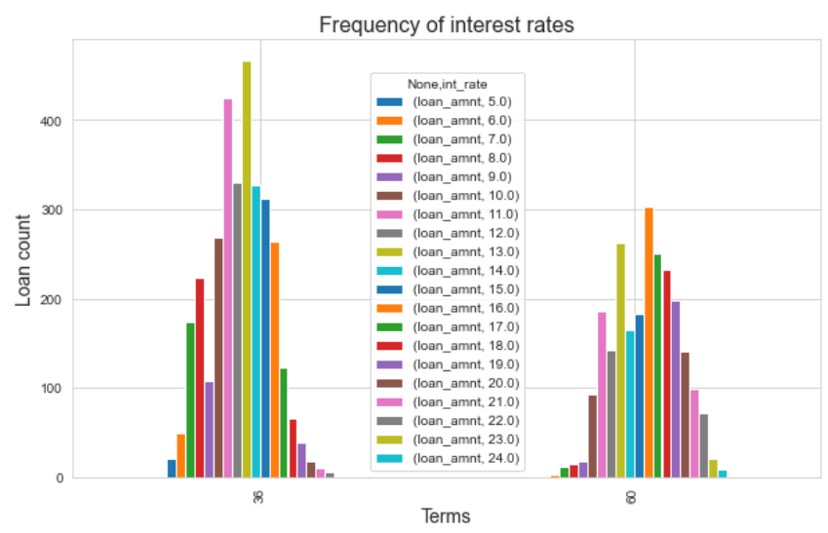
For either terms, if the interest rate is reduced, defaulting behavior can be reduced

Slide 19
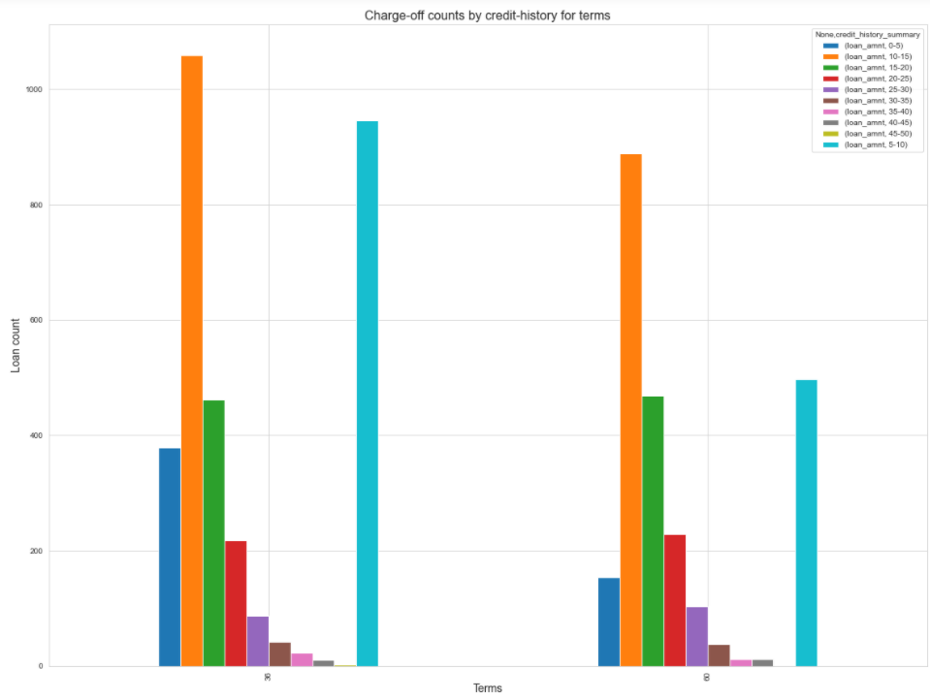
Giving loan to a customer with credit history between 5 - 15 years in the top 4 states, for the last quarter of the year, for top 4 purposes is risky.

Slide 20
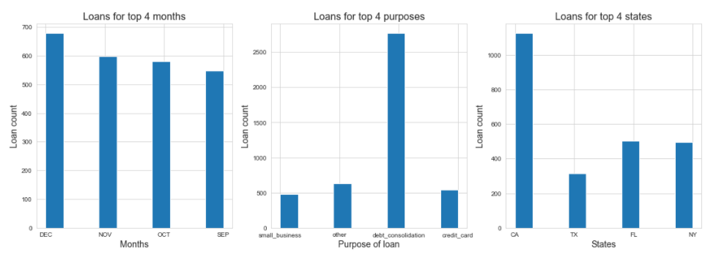
Issuing loans in Sep-Dec (specifically Nov and Dec), for the 4 states with debt consolidation as purpose is risky. Customers ask for loan with debt consolidation as a reason in the 4 (especially California) states and default maximum. Towards the end of the year, as celebration begins, customers prepare to take the loan and spend-off and default.

Slide 21
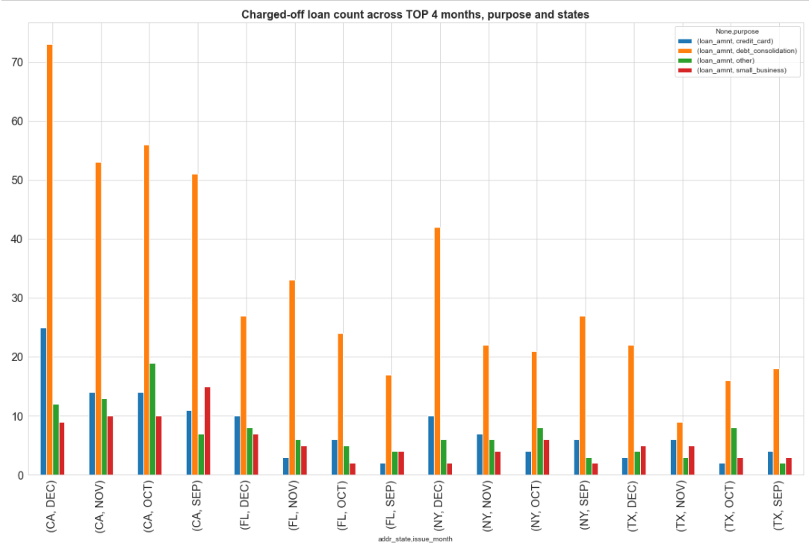
Issuing loans in Sep-Dec (specifically Nov and Dec), for the 4 states with debt consolidation as purpose is risky. Customers ask for loan with debt consolidation as a reason in the 4 (especially California) states and default maximum. Towards the end of the year, as celebration begins, customers prepare to take the loan and spend-off and default.

Slide 22
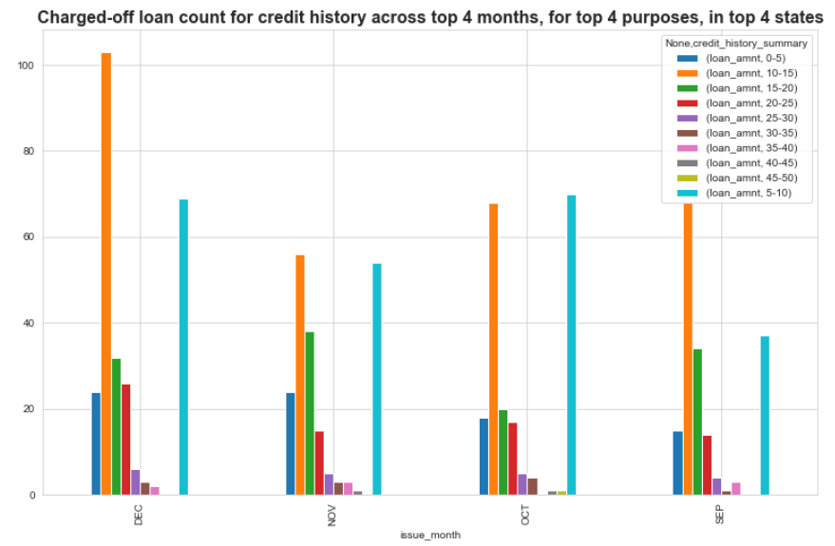
Giving loan to a customer with credit history between 5 - 15 years in the top 4 states, for the last quarter of the year, for top 4 purposes is risky.

Slide 23
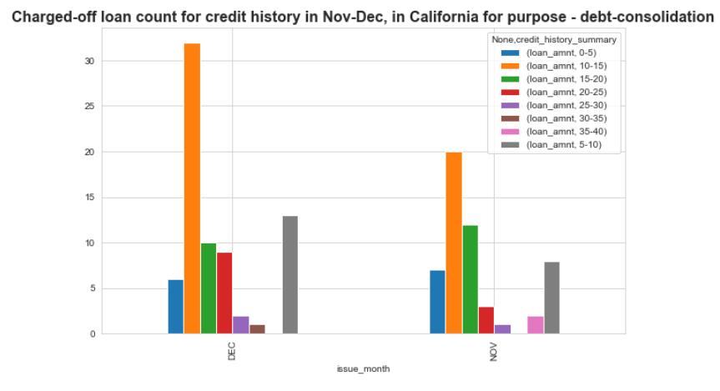
Giving loan to a customer with credit history between 5 - 15 years in the top 4 states, for the last quarter of the year, for top 4 purposes is risky.

Slide 24
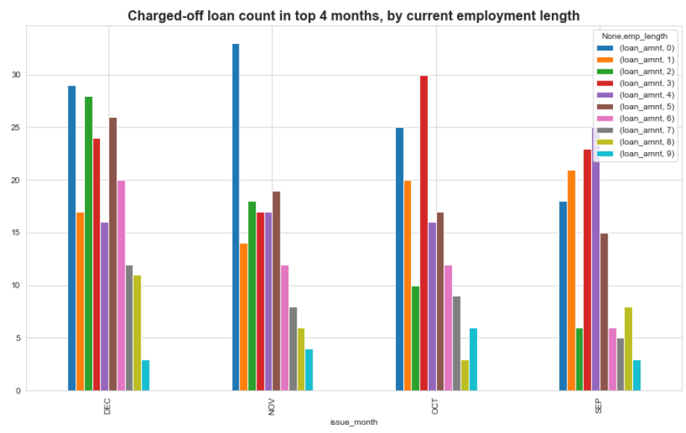
Lending money to customers fitting top 4 criteria with employment length less than 2 years is risky.

Slide 25
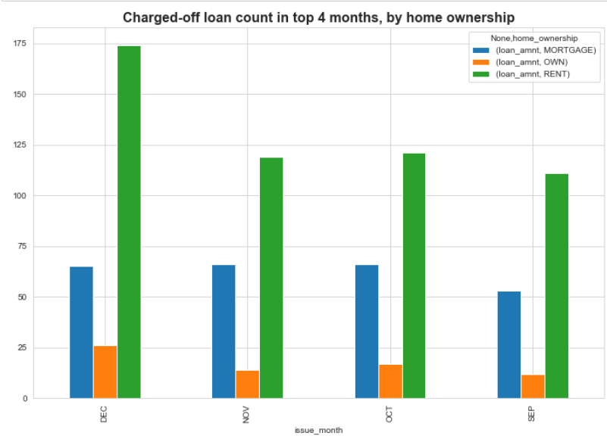
If a customer fitting top 4 criteria in rental home, applies for
loan with purpose debt consolidation in the last 4 months, its risky.

Slide 26
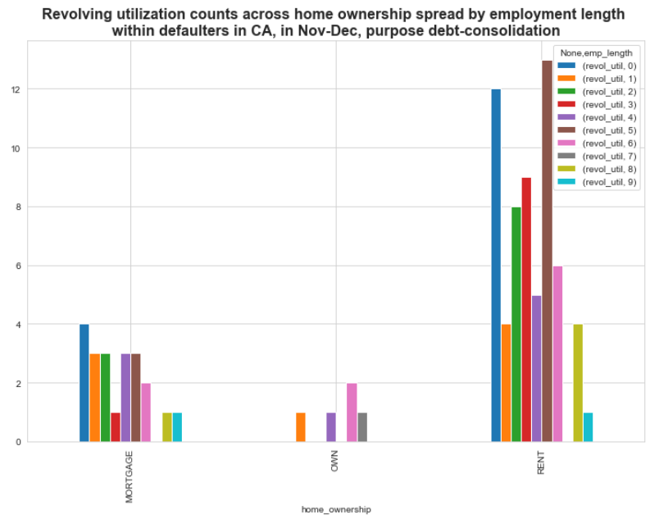
For rental customers, revolving utilization is highest, and specifically, it reduces as they spend more number of years with the same employer. So many reasons for calling rental clients risky

Slide 27
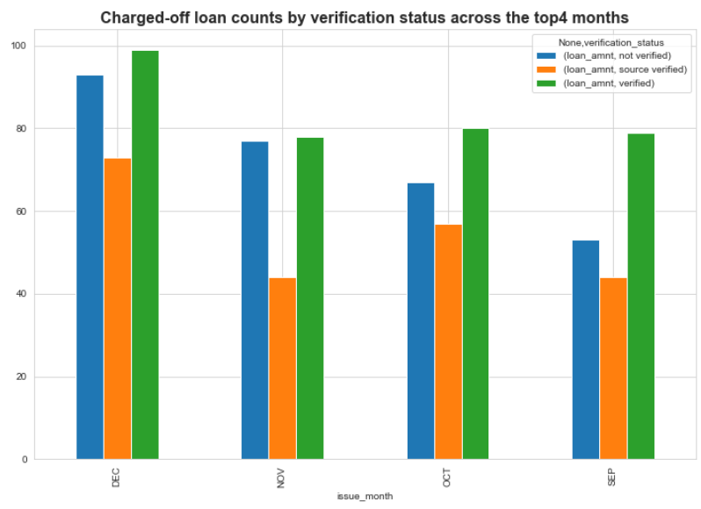
When loans are issued without source verification, they are very risky.

Slide 28
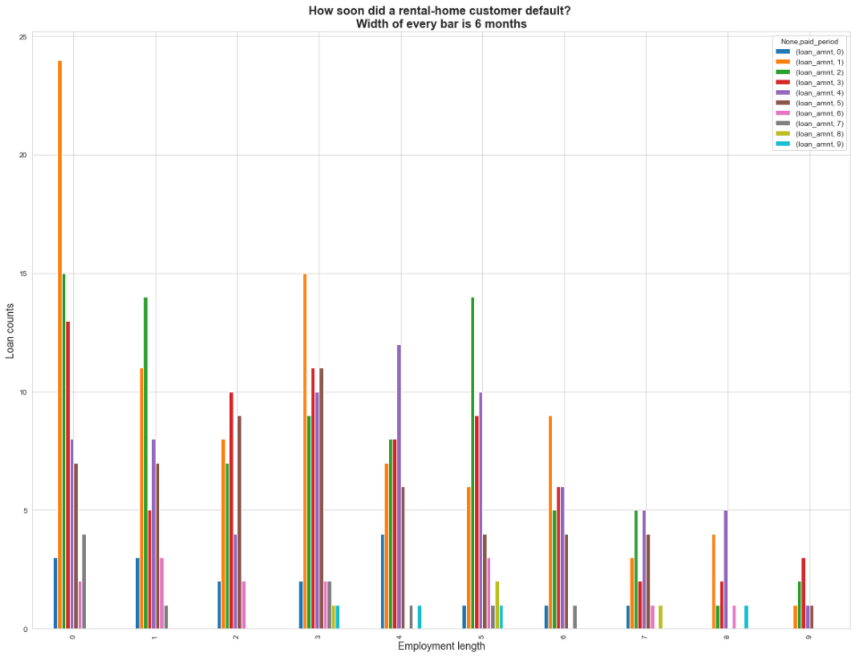
Rental home defaulters, default within the first 6, 12 and 18 months, if they are employed for a shorter time in their current job.

Slide 29
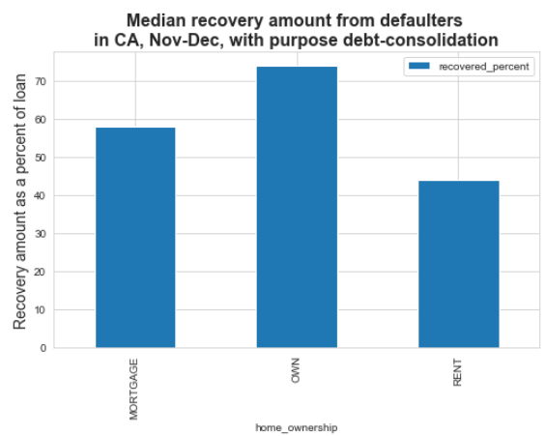
Its risky to give loan to rental customers, because its risky to recover the amount incase of default

Slide 30
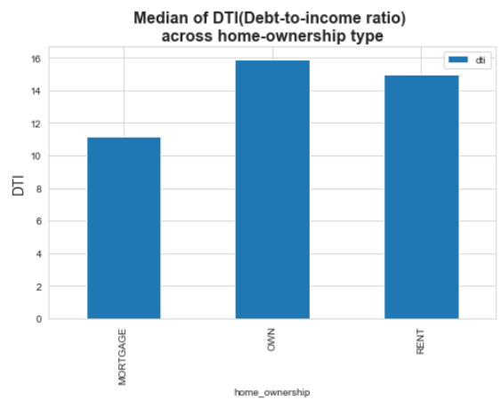
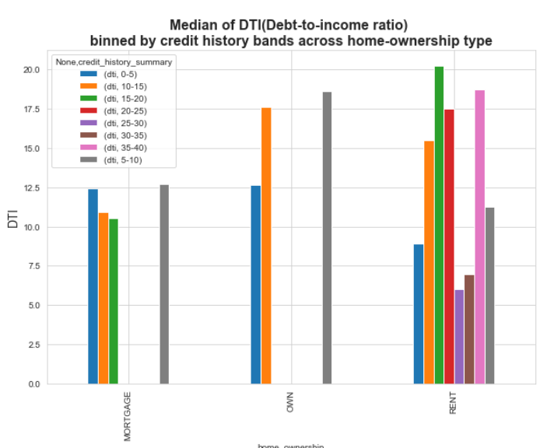
Risky to give loans to rental customers with higher DTI.

Slide 31
Conclusion

